Slide 1

React Lifecycle methods & hooks

Slide 2
React lifecycle methods
You can think of React lifecycle methods as the series of events that happen from the birth of a React component to its death.

Slide 3
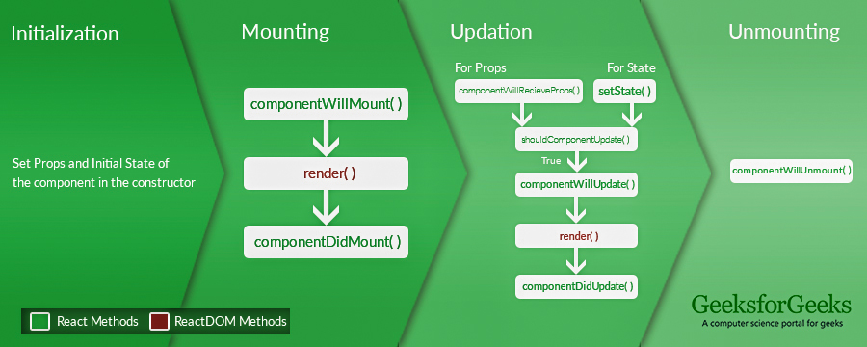
REACT’s LIFECYCLE before v16.0

Slide 4
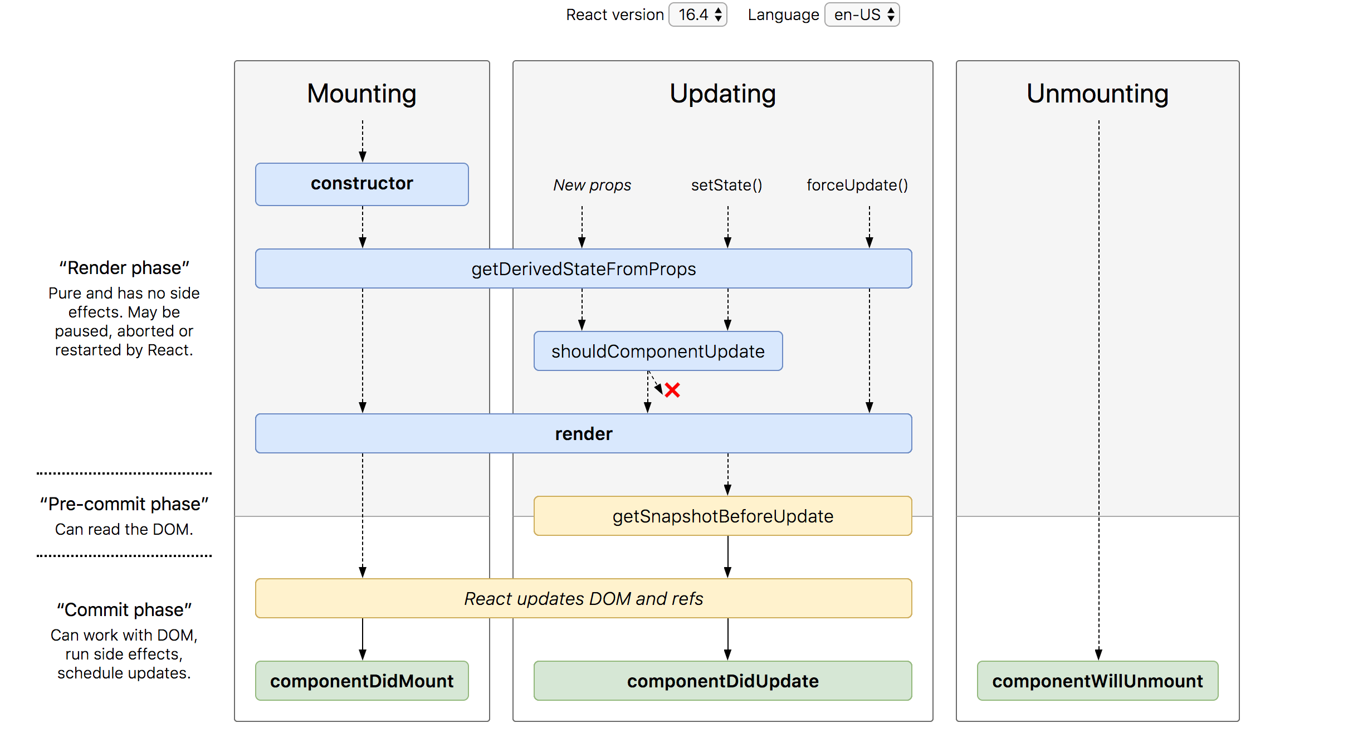
Lifecycle v16.0

Slide 5
What’s the deal with lifecycle methods anyway?
class HelloWorld extends React.Component {
render() {
return <h1> Hello World </h1>
} }
When this component is rendered and viewed on a client, The component had gone through a couple of phases before getting here. These phases are generally referred to as the component lifecycle.
For humans, we get, child, adult, elderly. For React components, we have, mounting, updating and unmounting.

Slide 6
Mounting
This is the component’s first glimpse of life.
This is the very first phase the component goes through
It is at this phase the component is created (your code, and react’s internals) then inserted into the DOM.

Slide 7
Updating
For react components, without updates, the component will remain as they were when they were created in the DOM world.
A good number of components you write get updated — whether that’s via a change in state or props. Consequently, they go through this phase as well. the updating phase.

Slide 8
unmounting
At this stage, the component “dies”. In React lingo, it is being removed from its world — the DOM.

Slide 9
error handling
There’s one more phase a React component goes through. Sometimes code doesn’t run or there’s a bug somewhere. Well, don’t fret. The component is going through the error handling phase. Similar to a human visiting the doctor.

Slide 10
overview
Mounting — It is at this phase the component is created (your code, and react’s internals) then inserted into the DOM
Updating — A React component “grows”
Unmounting — Final phase
Error Handling — Sometimes code doesn’t run or there’s a bug somewhere

Slide 11
Key :
A React component may NOT go through all of the phases. The component could get mounted and unmounted the next minute — without any updates or error handling.

Slide 12
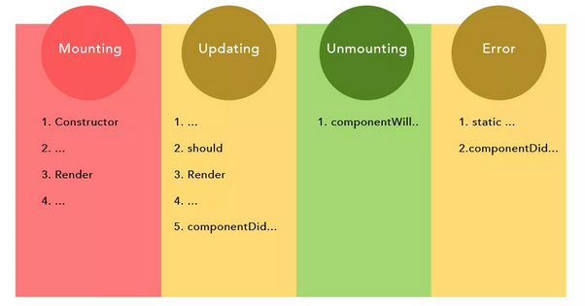

Slide 13
The mounting lifecycle methods
Constructor()
This is the very first method called as the component is “brought to life”
The constructor method is called before the component is mounted to the DOM.
Usually, you’d initialize state and bind event handlers methods within the constructor method.

Slide 14
Continue…
const MyComponent extends React.Component {
constructor(props) {
super(props)
this.state = {
points: 0
}
this.handlePoints = this.handlePoints.bind(this)
} }

Slide 15
The mounting lifecycle methods
Static getDerivedStateFromProps()
The method takes in state and props.
And you can either return an object to update the state of the component
Or return null to make no updates
Well, it is one of the rarely used lifecycle methods, but it comes in handy in certain scenarios.
Remember, this method is called (or invoked) before the component is rendered to the DOM on initial mount.

Slide 16
Continue…
If you remember from the previous explanation, this method is called before the component is mounted to the DOM. By returning an object, we update the state of the component before it is even rendered.
So If we initialize state in constructor and then use this method we can update the state before it gets rendered on screen.
Essentially, this method allows a component to update its internal state in response to a change in props which previously was done through componentWillReceiveProps.

Slide 17
The mounting lifecycle methods
Render
If you want to render elements to the DOM, the render method is where you write this (as shown above) i.e. returning some JSX.
In the event that you don’t want to render anything, you could return a Boolean or NULL within the render method.
An important thing to note about the render method is that the render function should be pure i.e. do not attempt to use setState or interact with the external APIs.

Slide 18
The mounting lifecycle methods
ComponentDidMount()
This function is invoked immediately after the component is mounted to the DOM.
Sometimes you need to grab a DOM node from the component tree immediately after it’s mounted. This is the right component lifecycle method to do this.
For example, you could have a modal and want to render the content of the modal within a specific DOM element
If you also want to make network requests as soon as the component is mounted to the DOM, this is a perfect place to do so as well.

Slide 19
The updating lifecycle methods
Whenever a change is made to the state or props of a react component, the component is re-rendered. In simple terms, the component is updated. This is the updating phase of the component lifecycle.
Static getDerivedStateFromProps()

Slide 20
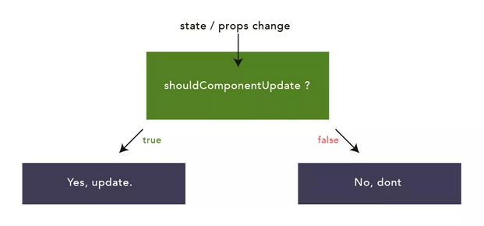
The updating lifecycle methods
shouldComponentUpdate()
By default, or in most cases, you’ll want a component to re-render when state or props changes. However, you do have control over this behavior.

Slide 21
The updating lifecycle methods
shouldComponentUpdate()
This lifecycle method is mostly used for performance optimization measures.
However, this is a very common use case, so you could use the built-in PureComponent when you don’t want a component to re-render if the state or props don’t change.
render()

Slide 22
The updating lifecycle methods
getSnapshotBeforeUpdate()
Specifically used when you need to grab some information from the DOM (and potentially change it) just after an update is made.
The value queried from the DOM in getSnapshotBeforeUpdate()
will refer to the value just before the DOM is updated. Even though the render method was previously called.
An analogy that may help has to do with how you use version control systems such as git.

Slide 23
CONTINUE…
A basic example is that you write code, and stage your changes before pushing to the repo.
In this case, assume the render function was called to stage your changes before actually pushing to the DOM. So, before the actual DOM update, information retrieved from this refers to those before the actual visual DOM update.
Actual updates to the DOM may be asynchronous, but the getSnapshotBeforeUpdate () lifecycle method will always be called immediately before the DOM is updated.

Slide 24
Continue…
lifecycle method works is that when it is invoked, it gets passed the previous props and state as arguments.
Within this method, you’re expected to either return a value or NULL.
lifecycle method doesn’t work on its own. It is meant to be used in conjunction with the componentDidUpdate.

Slide 25
The updating lifecycle methods
componentDidUpdate()
method it receives the previous props and state as arguments:
whatever value is returned from the getSnapshotBeforeUpdate lifecycle method is passed as the third argument to the componentDidUpdate method.

Slide 26
The unmounting lifecycle method
componentWillUnmount()
lifecycle method is invoked immediately before a component is unmounted and destroyed. This is the ideal place to perform any necessary cleanup such as clearing up timers, cancelling network requests, or cleaning up any subscriptions that were created in ComponentDidMount().

Slide 27
The error handling lifecycle methods
Sometimes things go bad, errors are thrown. The following methods are invoked when an error is thrown by a descendant component i.e a component below them.
static getDerivedStateFromError()
Whenever an error is thrown in a descendant component, this method is called first, and the error thrown passed as an argument.
Whatever value is returned from this method is used to update the state of the component.

Slide 28
Continue…
componentDidCatch()
method is also called after an error in a descendant component is thrown. Apart from the error thrown, it is passed one more argument which represents more information about the error.
In this method, you can send the error or info received to an external logging service.

Slide 29
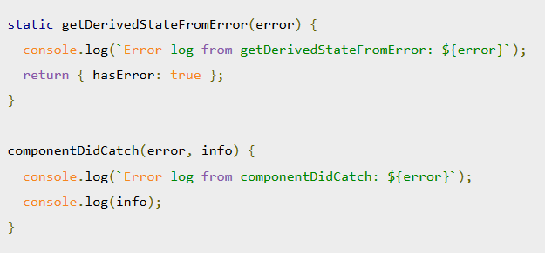

Slide 30
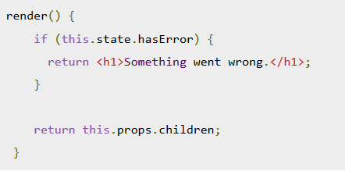

Slide 31
React Hooks

Slide 32
UseState()

Slide 33
Refactoring from a class to functional component
 | export default class Planets extends Component {
 | state = {
 | hasErrors: false,
 | planets: {}
 | };
 | componentDidMount() {
 | fetch("https://swapi.co/api/planets/4/")
 | .then(res => res.json())
 | .then(res => this.setState({ planets: res }))
 | .catch(() => this.setState({ hasErrors: true }));
 | }
 | render() {
 | return <div>{JSON.stringify(this.state.planets)}</div>;
 | }
 | }

Slide 34
Convert to functional component
 | const Planets = () => {
 | const [hasError, setErrors] = useState(false)
 | const [planets,setPlanets ]= useState({})
 | componentDidMount() {
 | fetch("https://swapi.co/api/planets/4/")
 | .then(res => res.json())
 | .then(res => this.setState({ planets: res }))
 | .catch(() => this.setState({ hasErrors: true }));
 | }
 | return (
 | <div>{JSON.stringify(planets)}</div>
 | )
 | }
 | export default Planets;

Slide 35
useEffect()

Slide 36
Effects
lets you perform side effects in function components.
Data fetching, setting up a subscription, and manually changing the DOM in React components are all examples of side effects.
React hook which accepts a callback as it’s the first argument. Inside the first argument, we do all the effect related tasks.

Slide 37
Effects
 | import React, { useState, useEffect } from "react";
 | const Planets = () => {
 | const [hasError, setErrors] = useState(false);
 | const [planets, setPlanets] = useState({});
 | useEffect(() =>
 | fetch("https://swapi.co/api/planets/4/")
 | .then(res => res.json())
 | .then(res => this.setState({ planets: res }))
 | .catch(() => this.setState({ hasErrors: true }))
 | );
 | return <div>{JSON.stringify(planets)}</div>;
 | };
 | export default Planets;

Slide 38
Advantages…
By using this Hook, you tell React that your component needs to do something after render. React will remember the function you passed (we’ll refer to it as our “effect”) and call it later after performing the DOM updates.
Could be used with functional components only.

Slide 39
Changing setState to hooks

Slide 40
Final Example
 | Const Planets = () => {
 | const [hasError, setErrors] = useState(false);
 | const [planets, setPlanets] = useState({});
 | async function fetchData() {
 | const res = await fetch("https://swapi.co/api/planets/4/");
 | res
 | .json()
 | .then(res => setPlanets(res))
 | .catch(err => setErrors(err));
 | }
 | useEffect(() => {
 | fetchData();
 | });
 | return (
 | <div>
 | <span>{JSON.stringify(planets)}</span>
 | <hr />
 | <span>Has error: {JSON.stringify(hasError)}</span>
 | </div>
 | );
 | };
 | export default Planets;

Slide 41
Thank You ☺

